Slide 1
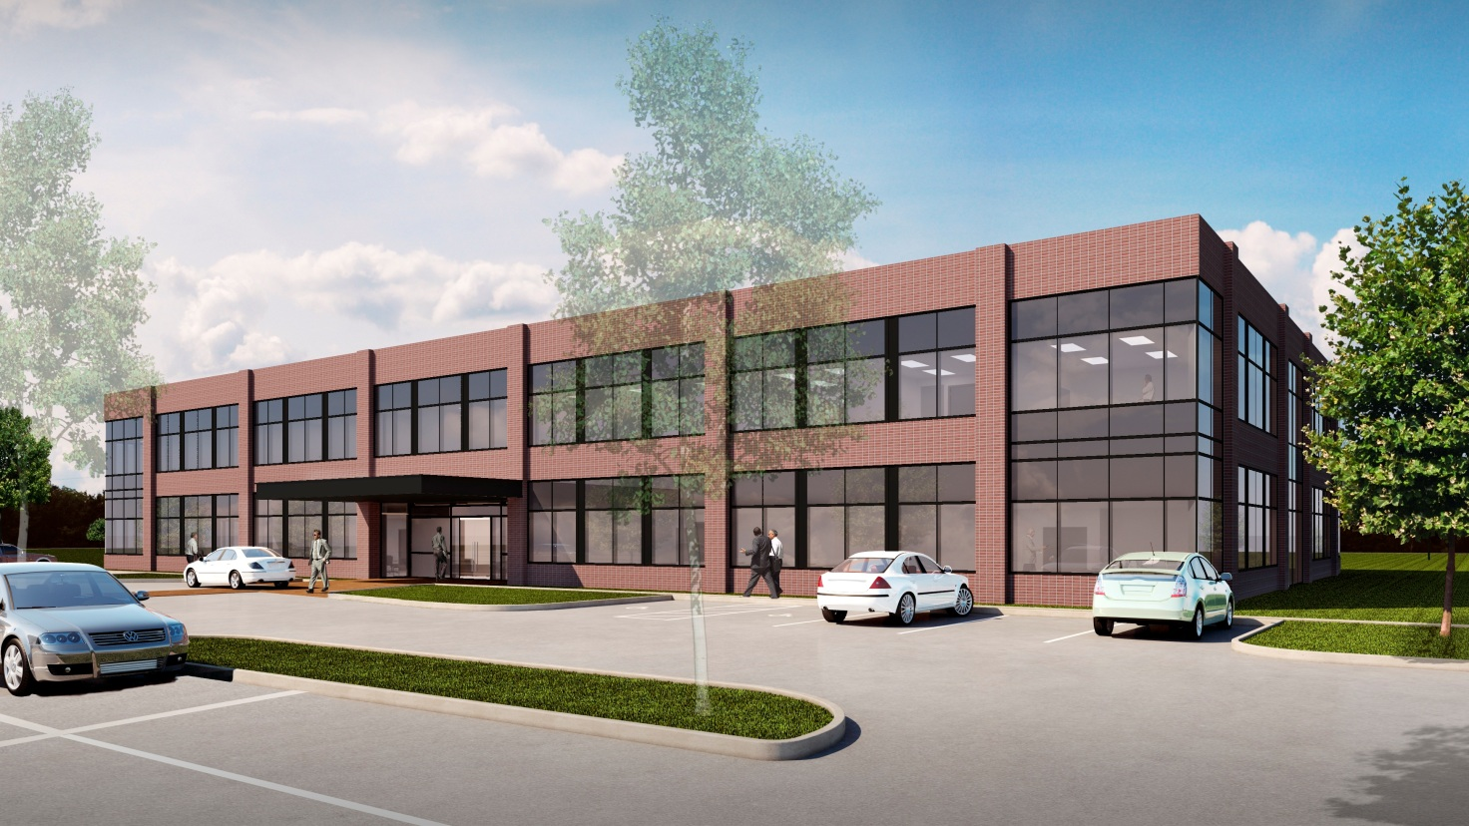
Fisk Corporate Headquarters
Houston, Texas
Penn State AE Senior Capstone Project
Stephen Blanchard – Construction Management Option
Advisor: Dr. John Messner

Slide 2



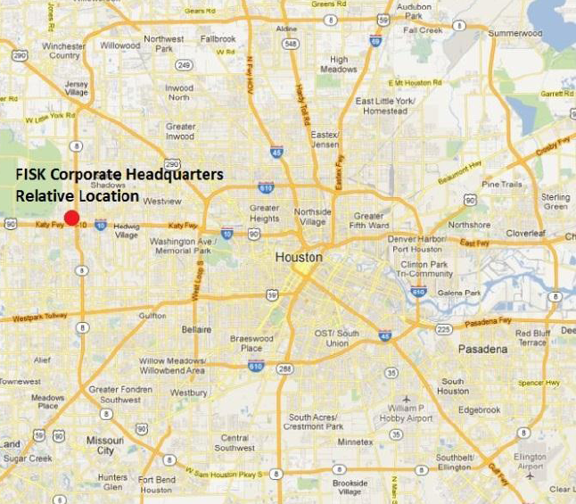

Stephen Blanchard
Construction Management
Project Summary
Fisk Corporate Headquarters
Houston, Texas
Project Summary
Analysis #1: Project Sequencing
Sequencing Process
Schedule Results
Cost Implications
Analysis #2: Electrical System Redesign
Electrical Redesign
Redesign Impacts
Analysis #3: Implementation of LEED
LEED Cost Analysis
Architectural Breadth
Energy Impacts
BIM Research
Final Recommendations
Acknowledgments
Project Location
Houston, Texas
Building Information
Office Size: 37,780 Sq. Feet
Pre-Fab Size: 16,380 Sq. Feet
2 Stories Above Grade
Structural Steel
Construction Logistics
Cost: $7,957,144
Duration: 11/21/11 – 10/5/12
Delivery: Design-Bid-Build
Contract Type: Lump Sum
Ownership Team Information
Fisk Electric Corp.
Tutor Perini Corp.

Slide 3
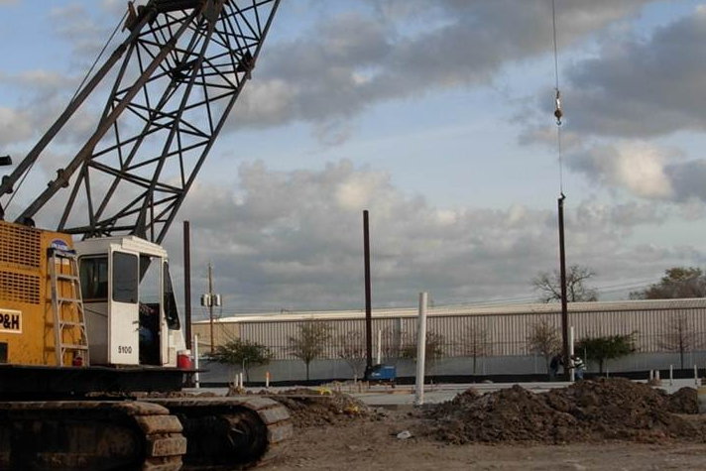
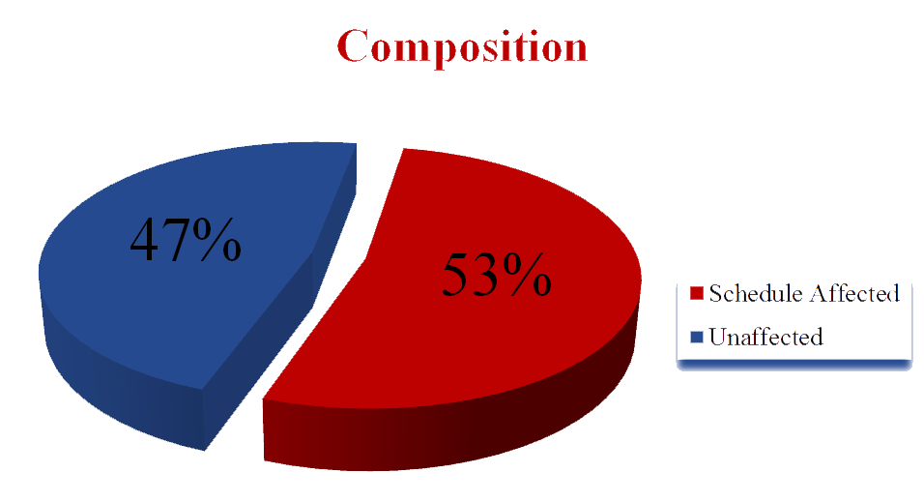
Stephen Blanchard
Construction Management
Project Sequencing
Fisk Corporate Headquarters
Houston, Texas
Project Summary
Analysis #1: Project Sequencing
Sequencing Process
Schedule Results
Cost Implications
Analysis #2: Electrical System Redesign
Electrical Redesign
Redesign Impacts
Analysis #3: Implementation of LEED
LEED Cost Analysis
Architectural Breadth
Energy Impacts
BIM Research
Final Recommendations
Acknowledgments
Problem Identification
47 Week Construction Duration
Scheduling Gaps
Limited Activity Overlap (Finish to Start)
Background
Extensive General Conditions Implications
Fisk Electric Carried General Conditions
Includes Tutor Perini Staffing and Fees
General Conditions Overview
Total Cost: $1,122,906
14% of Construction Costs

Slide 4
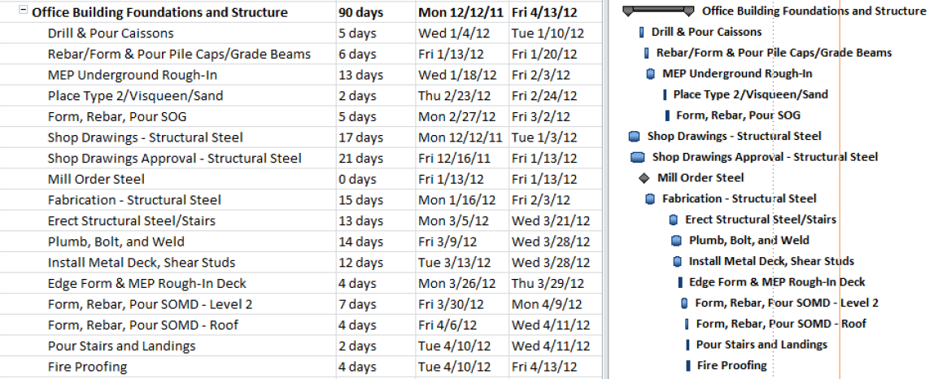
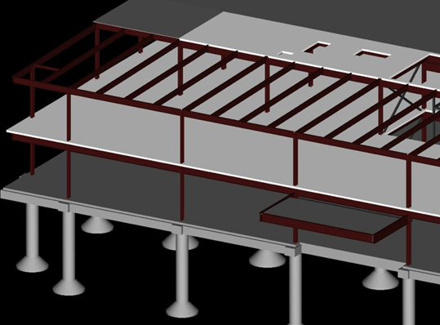
Stephen Blanchard
Construction Management
Project Sequencing
Fisk Corporate Headquarters
Houston, Texas
Project Summary
Analysis #1: Project Sequencing
Sequencing Process
Schedule Results
Cost Implications
Analysis #2: Electrical System Redesign
Electrical Redesign
Redesign Impacts
Analysis #3: Implementation of LEED
LEED Cost Analysis
Architectural Breadth
Energy Impacts
BIM Research
Final Recommendations
Acknowledgments
Original Structure Erection Schedule
Duration: 90 Days
All Activities on Critical Path
Relationships: Finish to Start (All Activities)
Separated Pours

Slide 5
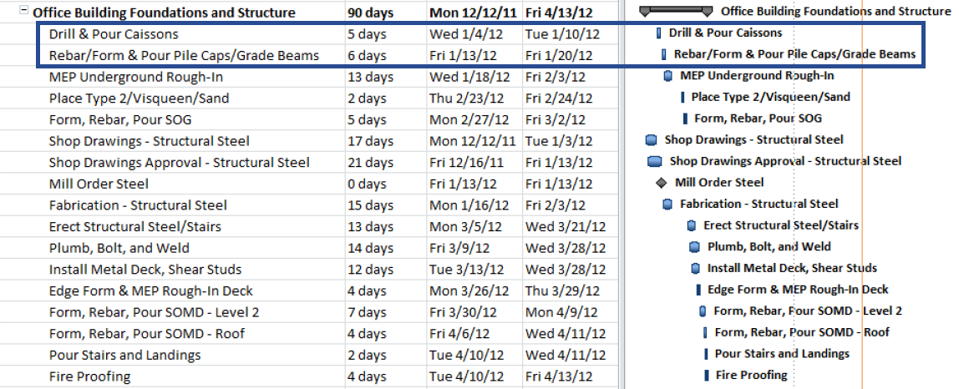
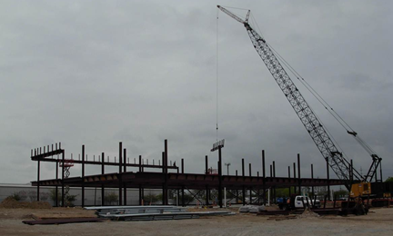
Stephen Blanchard
Construction Management
Project Sequencing
Fisk Corporate Headquarters
Houston, Texas
Project Summary
Analysis #1: Project Sequencing
Sequencing Process
Schedule Results
Cost Implications
Analysis #2: Electrical System Redesign
Electrical Redesign
Redesign Impacts
Analysis #3: Implementation of LEED
LEED Cost Analysis
Architectural Breadth
Energy Impacts
BIM Research
Final Recommendations
Acknowledgments
Re-Sequencing Process
1. Remove All Schedule Gaps
2. Re-Sequence Activities
3. Identify Potential Overlap

Slide 6
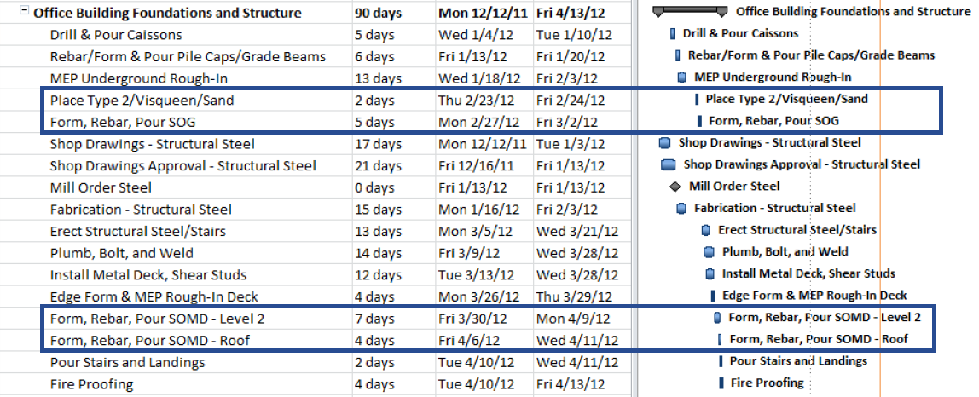
Stephen Blanchard
Construction Management
Project Sequencing
Fisk Corporate Headquarters
Houston, Texas
Project Summary
Analysis #1: Project Sequencing
Sequencing Process
Schedule Results
Cost Implications
Analysis #2: Electrical System Redesign
Electrical Redesign
Redesign Impacts
Analysis #3: Implementation of LEED
LEED Cost Analysis
Architectural Breadth
Energy Impacts
BIM Research
Final Recommendations
Acknowledgments
Re-Sequencing Process
1. Remove All Schedule Gaps
2. Re-Sequence Activities
3. Identify Potential Overlap
One
Month

Slide 7
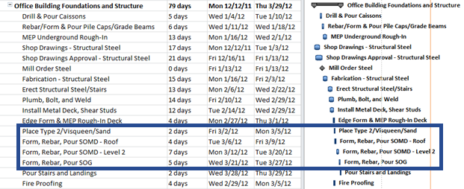
Stephen Blanchard
Construction Management
Project Sequencing
Fisk Corporate Headquarters
Houston, Texas
Project Summary
Analysis #1: Project Sequencing
Sequencing Process
Schedule Results
Cost Implications
Analysis #2: Electrical System Redesign
Electrical Redesign
Redesign Impacts
Analysis #3: Implementation of LEED
LEED Cost Analysis
Architectural Breadth
Energy Impacts
BIM Research
Final Recommendations
Acknowledgments
Re-Sequencing Process
1. Remove All Schedule Gaps
2. Re-Sequence Activities
3. Identify Potential Overlap

Slide 8
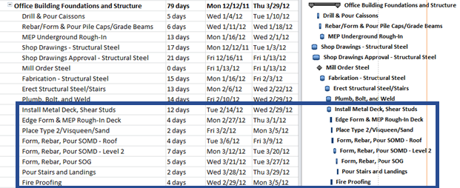
Stephen Blanchard
Construction Management
Project Sequencing
Fisk Corporate Headquarters
Houston, Texas
Project Summary
Analysis #1: Project Sequencing
Sequencing Process
Schedule Results
Cost Implications
Analysis #2: Electrical System Redesign
Electrical Redesign
Redesign Impacts
Analysis #3: Implementation of LEED
LEED Cost Analysis
Architectural Breadth
Energy Impacts
BIM Research
Final Recommendations
Acknowledgments
Re-Sequencing Process
1. Remove All Schedule Gaps
2. Re-Sequence Activities
3. Identify Potential Overlap

Slide 9
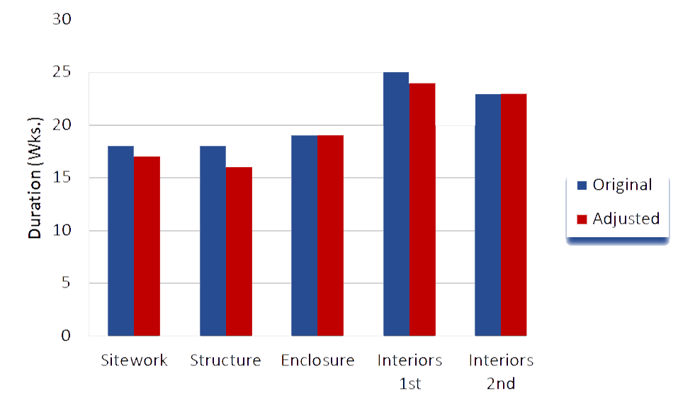
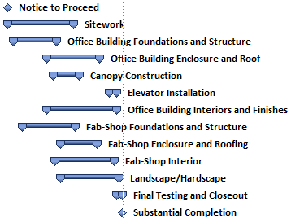
Stephen Blanchard
Construction Management
Project Sequencing
Fisk Corporate Headquarters
Houston, Texas
Project Summary
Analysis #1: Project Sequencing
Sequencing Process
Schedule Results
Cost Implications
Analysis #2: Electrical System Redesign
Electrical Redesign
Redesign Impacts
Analysis #3: Implementation of LEED
LEED Cost Analysis
Architectural Breadth
Energy Impacts
BIM Research
Final Recommendations
Acknowledgments
Duration Results
Overall Schedule Reduced by 4 Weeks
No Activity Durations Were Altered
Phase Reductions
Office Sitework: 1 Week
Office Structure: 2 Weeks
Office Interiors: 1 Week
Non-Critical Path Phase Reductions
Fab-Shop Enclosure: 7 Weeks
Fab-Shop Interior: 2 Weeks
Landscape/Hardscape: 2 Weeks
Phase Duration Comparison

Slide 10
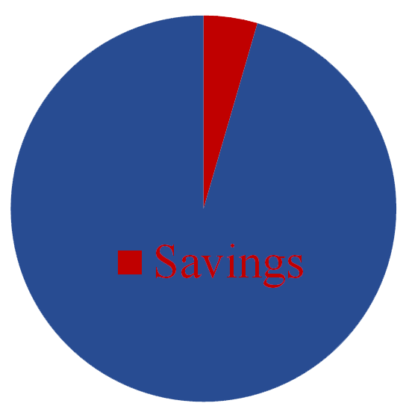
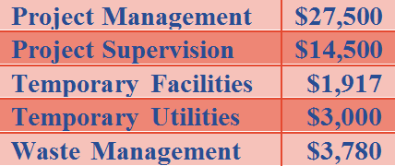
Stephen Blanchard
Construction Management
Project Sequencing
Fisk Corporate Headquarters
Houston, Texas
Project Summary
Analysis #1: Project Sequencing
Sequencing Process
Schedule Results
Cost Implications
Analysis #2: Electrical System Redesign
Electrical Redesign
Redesign Impacts
Analysis #3: Implementation of LEED
LEED Cost Analysis
Architectural Breadth
Energy Impacts
BIM Research
Final Recommendations
Acknowledgments
Cost Implications
$50,698 Total GC Savings
Savings Type
$45,780 in Weekly Savings
$4,917 in Monthly Savings
Non-Quantifiable
Activity Duration Reductions
Crew Mobilizations
Crew Consistency
General Conditions Savings Breakdown
General Conditions 5% Savings

Slide 11
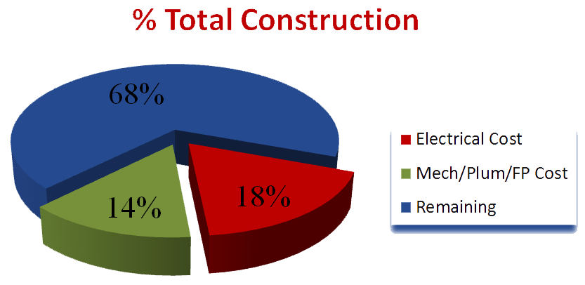
Stephen Blanchard
Construction Management
Electrical System Redesign
Fisk Corporate Headquarters
Houston, Texas
Project Summary
Analysis #1: Project Sequencing
Sequencing Process
Schedule Results
Cost Implications
Analysis #2: Electrical System Redesign
Electrical Redesign
Redesign Impacts
Analysis #3: Implementation of LEED
LEED Cost Analysis
Architectural Breadth
Energy Impacts
BIM Research
Final Recommendations
Acknowledgments
Problem Identification
$1,223,400 Electrical Cost
Costly Distribution System
Redundant Components

Slide 12
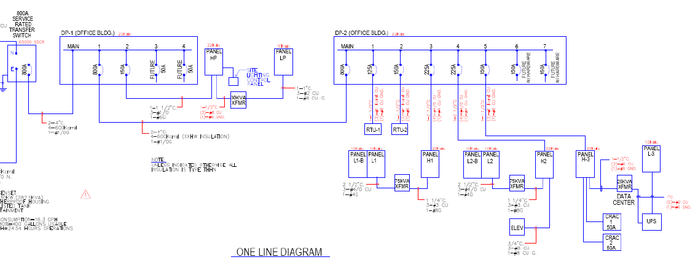
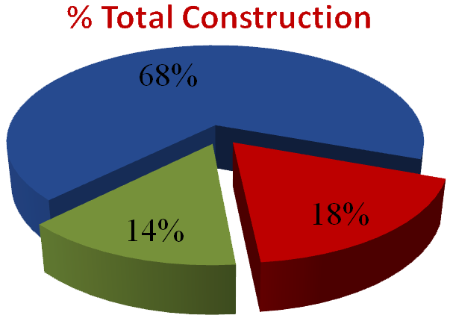
Stephen Blanchard
Construction Management
Electrical System Redesign
Fisk Corporate Headquarters
Houston, Texas
Project Summary
Analysis #1: Project Sequencing
Sequencing Process
Schedule Results
Cost Implications
Analysis #2: Electrical System Redesign
Electrical Redesign
Redesign Impacts
Analysis #3: Implementation of LEED
LEED Cost Analysis
Architectural Breadth
Energy Impacts
BIM Research
Final Recommendations
Acknowledgments
Problem Identification
$1,223,400 Electrical Cost
Costly Distribution System
Redundant Components
Original One-Line
Diagram

Slide 13
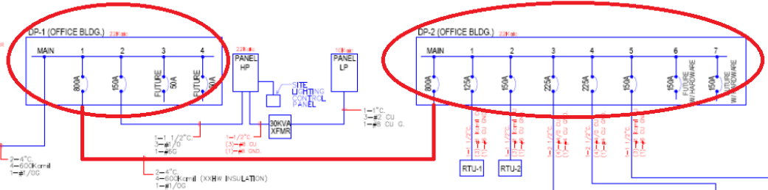
Stephen Blanchard
Construction Management
Electrical System Redesign
Fisk Corporate Headquarters
Houston, Texas
Project Summary
Analysis #1: Project Sequencing
Sequencing Process
Schedule Results
Cost Implications
Analysis #2: Electrical System Redesign
Electrical Redesign
Redesign Impacts
Analysis #3: Implementation of LEED
LEED Cost Analysis
Architectural Breadth
Energy Impacts
BIM Research
Final Recommendations
Acknowledgments
Redesign Process
1. Eliminate Distribution Panel Redundancy
2. Streamline Step-Down Voltage System
3. Back-Feed Data Center Distribution System
Eliminate Distribution Panel Redundancy

Slide 14
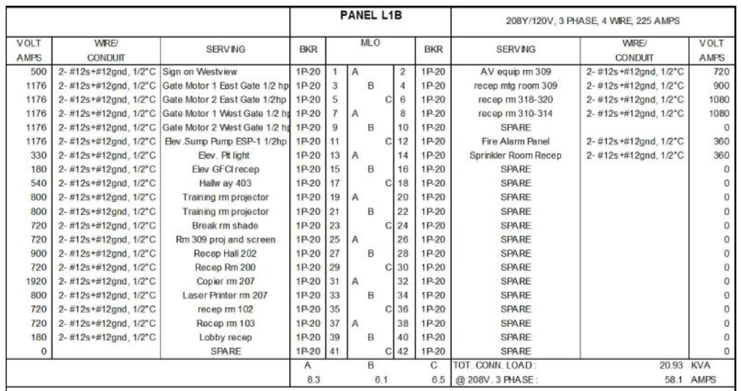
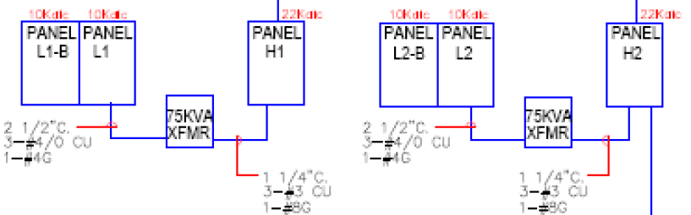
Stephen Blanchard
Construction Management
Electrical System Redesign
Fisk Corporate Headquarters
Houston, Texas
Project Summary
Analysis #1: Project Sequencing
Sequencing Process
Schedule Results
Cost Implications
Analysis #2: Electrical System Redesign
Electrical Redesign
Redesign Impacts
Analysis #3: Implementation of LEED
LEED Cost Analysis
Architectural Breadth
Energy Impacts
BIM Research
Final Recommendations
Acknowledgments
Redesign Process
1. Eliminate Distribution Panel Redundancy
2. Streamline Step-Down Voltage System
3. Back-Feed Data Center Distribution System
Streamline Step-Down Voltage System

Slide 15
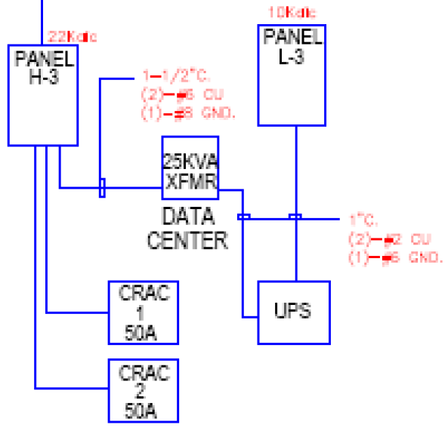

Stephen Blanchard
Construction Management
Electrical System Redesign
Fisk Corporate Headquarters
Houston, Texas
Project Summary
Analysis #1: Project Sequencing
Sequencing Process
Schedule Results
Cost Implications
Analysis #2: Electrical System Redesign
Electrical Redesign
Redesign Impacts
Analysis #3: Implementation of LEED
LEED Cost Analysis
Architectural Breadth
Energy Impacts
BIM Research
Final Recommendations
Acknowledgments
Redesign Process
1. Eliminate Distribution Panel Redundancy
2. Streamline Step-Down Voltage System
3. Back-Feed Data Center Distribution System
Back-Feed Data Center Distribution System

Slide 16
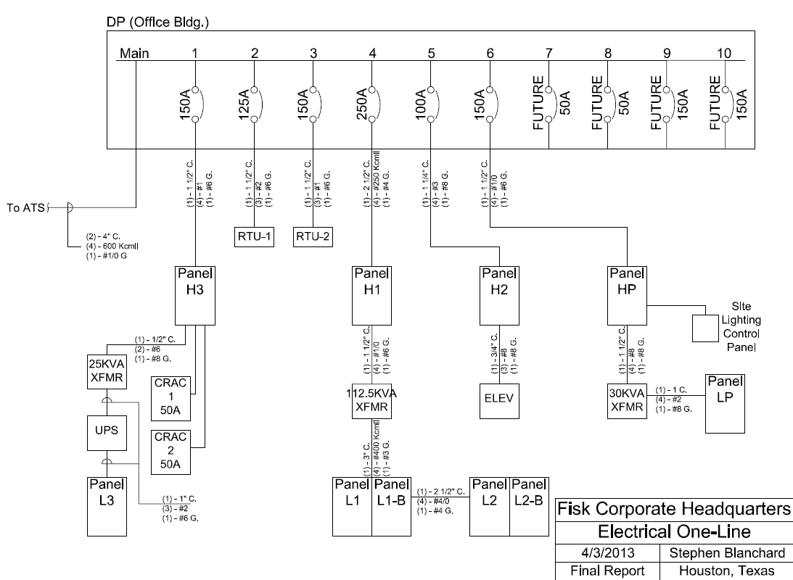
Stephen Blanchard
Construction Management
Electrical System Redesign
Fisk Corporate Headquarters
Houston, Texas
Project Summary
Analysis #1: Project Sequencing
Sequencing Process
Schedule Results
Cost Implications
Analysis #2: Electrical System Redesign
Electrical Redesign
Redesign Impacts
Analysis #3: Implementation of LEED
LEED Cost Analysis
Architectural Breadth
Energy Impacts
BIM Research
Final Recommendations
Acknowledgments

Slide 17
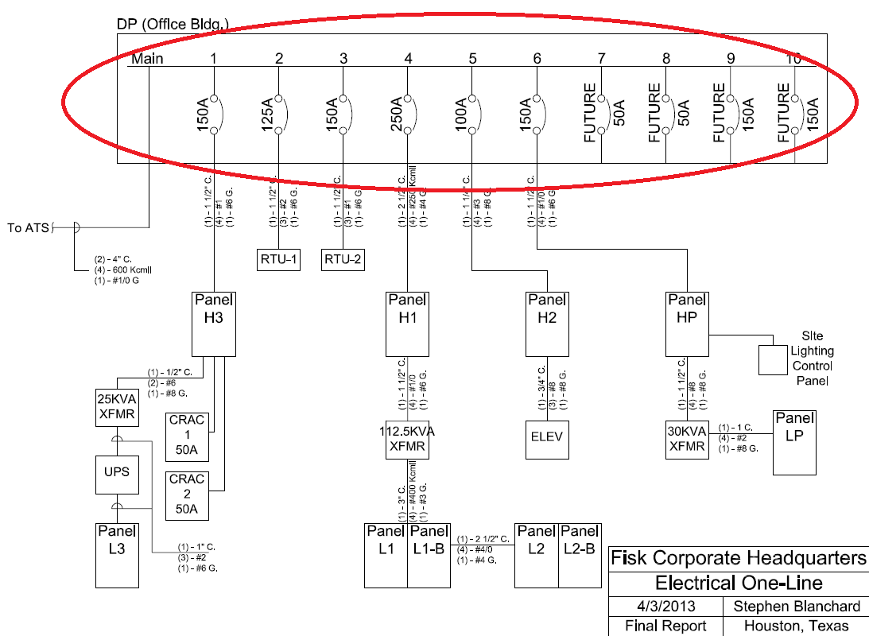
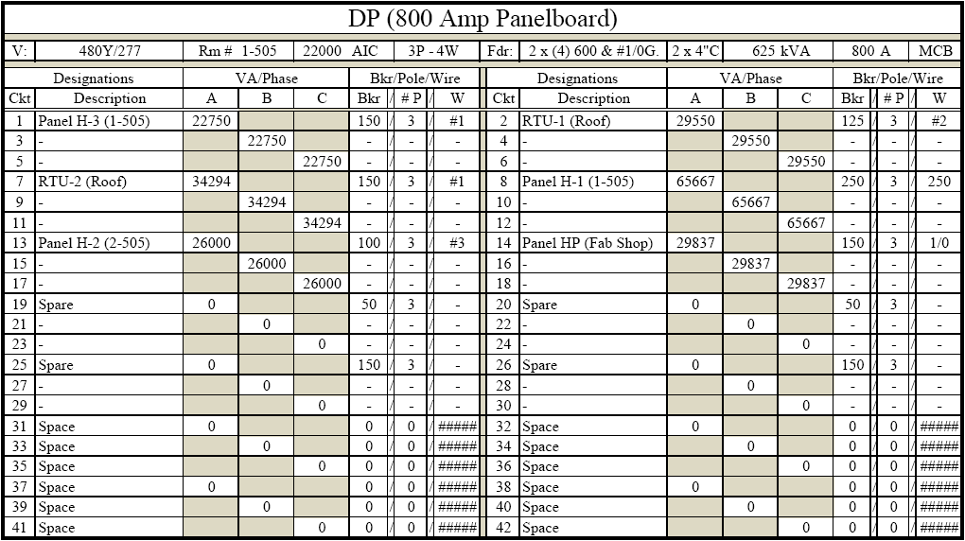
Stephen Blanchard
Construction Management
Electrical System Redesign
Fisk Corporate Headquarters
Houston, Texas
Project Summary
Analysis #1: Project Sequencing
Sequencing Process
Schedule Results
Cost Implications
Analysis #2: Electrical System Redesign
Electrical Redesign
Redesign Impacts
Analysis #3: Implementation of LEED
LEED Cost Analysis
Architectural Breadth
Energy Impacts
BIM Research
Final Recommendations
Acknowledgments
Redesign Results
1. Combined Distribution Panel
2. Single Step-Down Voltage Distribution System
3. Changes in Feeder Sizing and Distances
Combined Distribution Panel

Slide 18
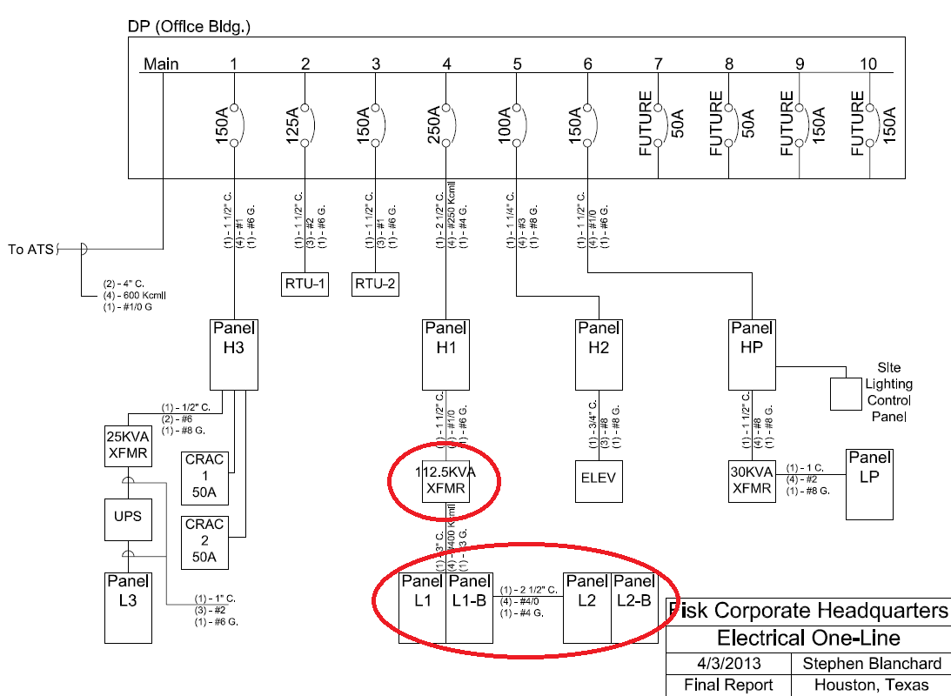
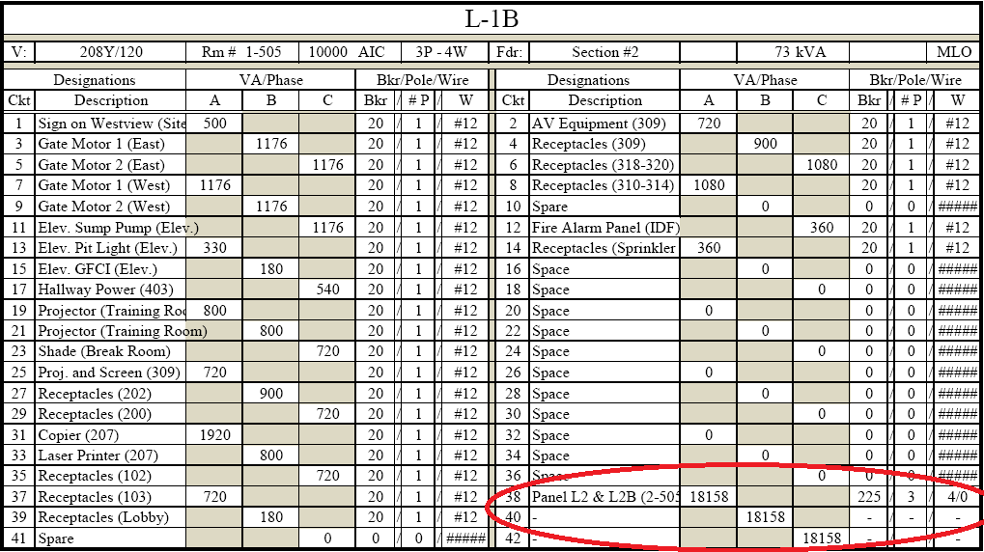
Stephen Blanchard
Construction Management
Electrical System Redesign
Fisk Corporate Headquarters
Houston, Texas
Project Summary
Analysis #1: Project Sequencing
Sequencing Process
Schedule Results
Cost Implications
Analysis #2: Electrical System Redesign
Electrical Redesign
Redesign Impacts
Analysis #3: Implementation of LEED
LEED Cost Analysis
Architectural Breadth
Energy Impacts
BIM Research
Final Recommendations
Acknowledgments
Redesign Results
1. Combined Distribution Panel
2. Single Step-Down Voltage Distribution System
3. Changes in Feeder Sizing and Distances
Single Step-Down Voltage Distribution System

Slide 19
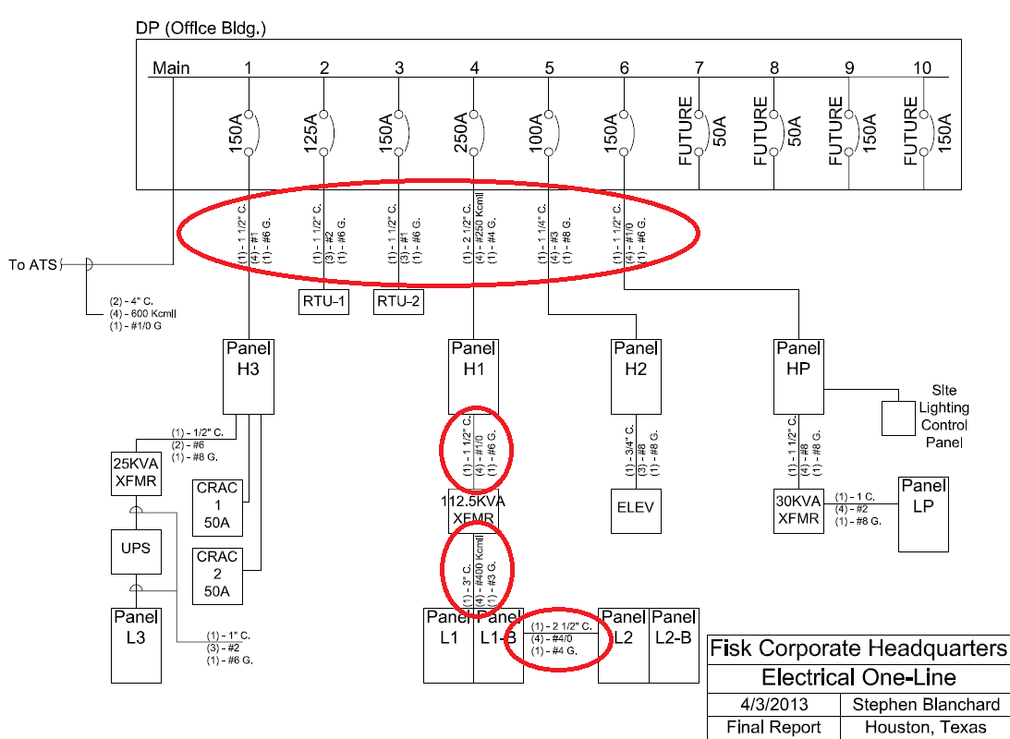
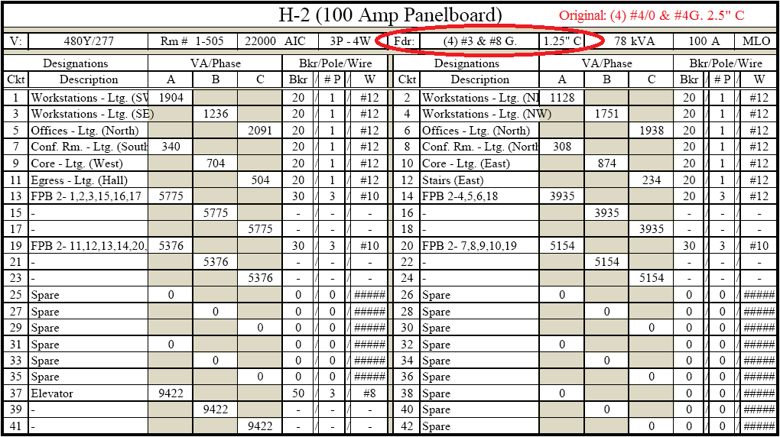
Stephen Blanchard
Construction Management
Electrical System Redesign
Fisk Corporate Headquarters
Houston, Texas
Project Summary
Analysis #1: Project Sequencing
Sequencing Process
Schedule Results
Cost Implications
Analysis #2: Electrical System Redesign
Electrical Redesign
Redesign Impacts
Analysis #3: Implementation of LEED
LEED Cost Analysis
Architectural Breadth
Energy Impacts
BIM Research
Final Recommendations
Acknowledgments
Redesign Results
1. Combined Distribution Panel
2. Single Step-Down Voltage Distribution System
3. Changes in Feeder Sizing and Distances
Changes in Feeder Sizing and Distances

Slide 20
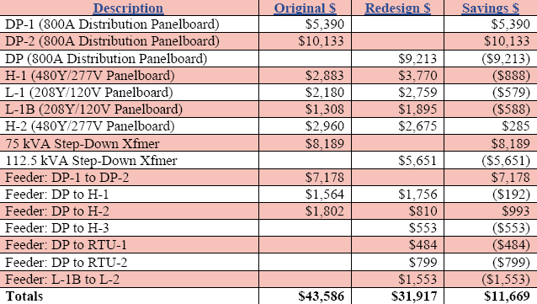
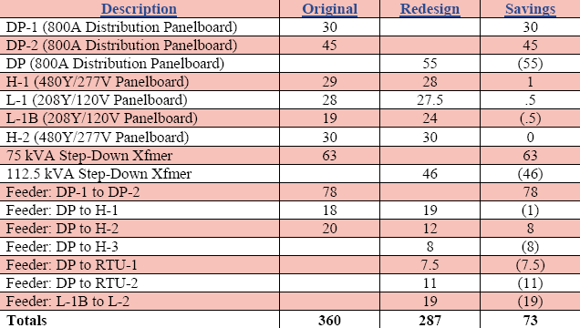
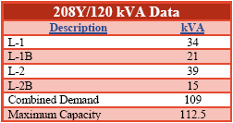
Stephen Blanchard
Construction Management
Electrical System Redesign
Fisk Corporate Headquarters
Houston, Texas
Project Summary
Analysis #1: Project Sequencing
Sequencing Process
Schedule Results
Cost Implications
Analysis #2: Electrical System Redesign
Electrical Redesign
Redesign Impacts
Analysis #3: Implementation of LEED
LEED Cost Analysis
Architectural Breadth
Energy Impacts
BIM Research
Final Recommendations
Acknowledgments
Constructability Concerns
David Rinehart
Ted Robertson
Cost Impacts
Schedule Impacts

Slide 21
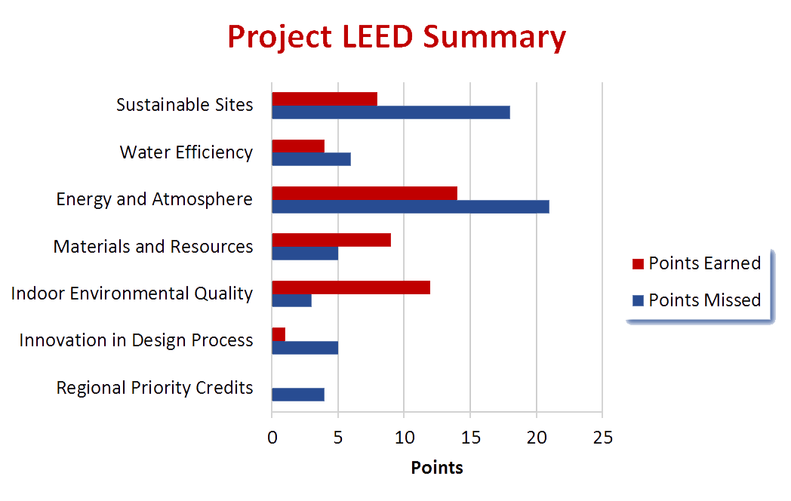

Stephen Blanchard
Construction Management
LEED Implementation
Fisk Corporate Headquarters
Houston, Texas
Project Summary
Analysis #1: Project Sequencing
Sequencing Process
Schedule Results
Cost Implications
Analysis #2: Electrical System Redesign
Electrical Redesign
Redesign Impacts
Analysis #3: Implementation of LEED
LEED Cost Analysis
Architectural Breadth
Energy Impacts
BIM Research
Final Recommendations
Acknowledgments
Business Case
Tax Incentives
1% Certified
2.5% Silver
Contractor Reputation
Project LEED Facts
A/E Instructed to Design LEED Facility
35% Additional Area – 60% of Electric Bill
48 Points Available w/ No Design Changes
Did Not Apply for LEED Building Certification
No Construction LEED Practices Implemented

Slide 22
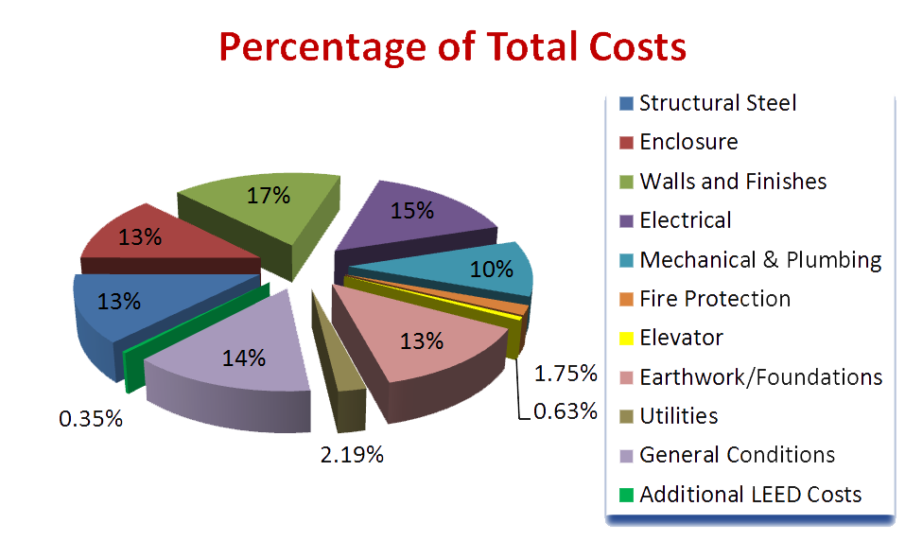
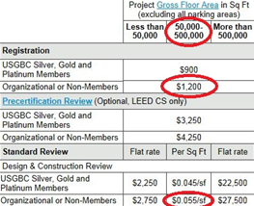
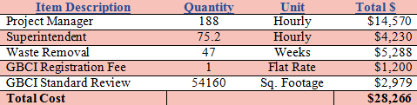
Stephen Blanchard
Construction Management
LEED Implementation
Fisk Corporate Headquarters
Houston, Texas
Project Summary
Analysis #1: Project Sequencing
Sequencing Process
Schedule Results
Cost Implications
Analysis #2: Electrical System Redesign
Electrical Redesign
Redesign Impacts
Analysis #3: Implementation of LEED
LEED Cost Analysis
Architectural Breadth
Energy Impacts
BIM Research
Final Recommendations
Acknowledgments
GBCI Fees
Construction LEED Implementation Cost Summary

Slide 23
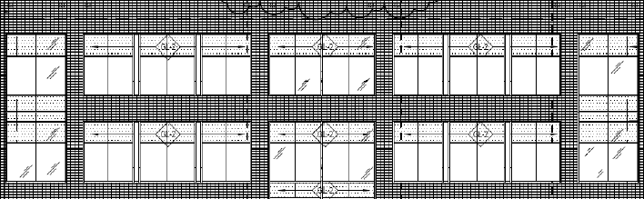
Stephen Blanchard
Construction Management
LEED Implementation
Fisk Corporate Headquarters
Houston, Texas
Project Summary
Analysis #1: Project Sequencing
Sequencing Process
Schedule Results
Cost Implications
Analysis #2: Electrical System Redesign
Electrical Redesign
Redesign Impacts
Analysis #3: Implementation of LEED
LEED Cost Analysis
Architectural Breadth
Energy Impacts
BIM Research
Final Recommendations
Acknowledgments
Problem Identification
2 Points from LEED Silver
7/19 Optimize Energy Performance Credits
2% Energy Efficiency Increase = 1 LEED Credit
Goal – Improve Energy Efficiency by 4%
Currently No Window Shading System
Western/Eastern Facade

Slide 24
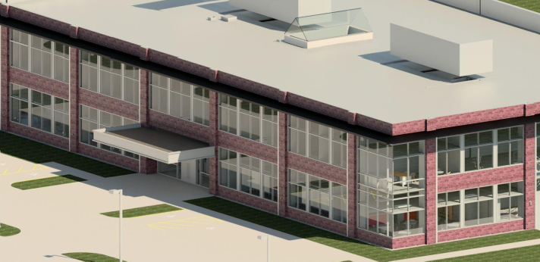
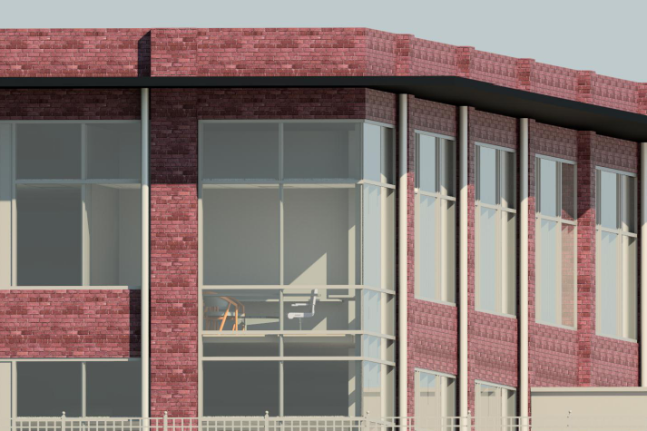
Stephen Blanchard
Construction Management
LEED Implementation
Fisk Corporate Headquarters
Houston, Texas
Project Summary
Analysis #1: Project Sequencing
Sequencing Process
Schedule Results
Cost Implications
Analysis #2: Electrical System Redesign
Electrical Redesign
Redesign Impacts
Analysis #3: Implementation of LEED
LEED Cost Analysis
Architectural Breadth
Energy Impacts
BIM Research
Final Recommendations
Acknowledgments
Architectural Shade #1
6’ Overhang
Above Second Story Grazing
E, S, & W Facades
Material: Solid Black Aluminum Paneling
Supports: Steel Columns Buried in Ground
Southeastern Corner Façade Rendering
Southwestern Corner Façade Rendering

Slide 25
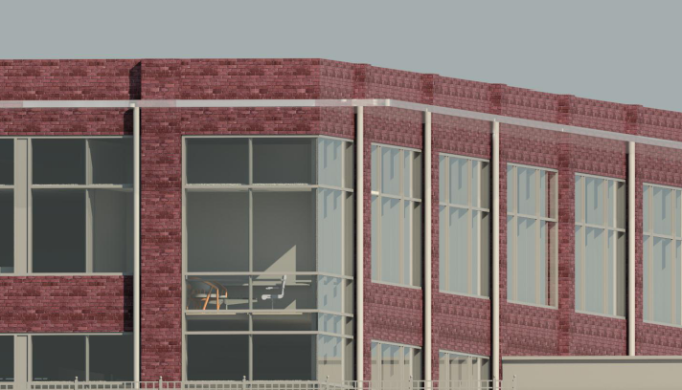
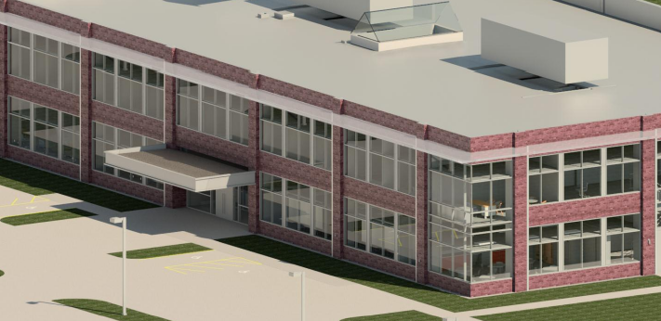
Stephen Blanchard
Construction Management
LEED Implementation
Fisk Corporate Headquarters
Houston, Texas
Project Summary
Analysis #1: Project Sequencing
Sequencing Process
Schedule Results
Cost Implications
Analysis #2: Electrical System Redesign
Electrical Redesign
Redesign Impacts
Analysis #3: Implementation of LEED
LEED Cost Analysis
Architectural Breadth
Energy Impacts
BIM Research
Final Recommendations
Acknowledgments
Architectural Shade #2
6’ Overhang
Above Second Story Grazing
E, S, & W Facades
Material: White, Acrylic Translucent Glazing
Supports: Steel Columns Buried in Ground
Southwestern Corner Façade Rendering
Southeastern Corner Façade Rendering

Slide 26
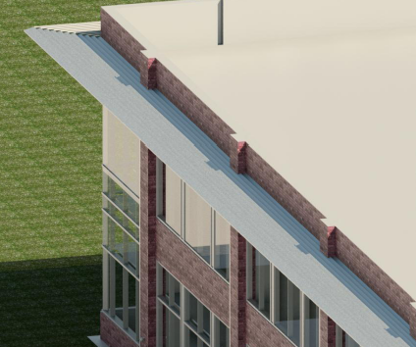
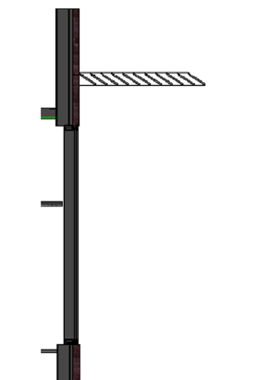
Stephen Blanchard
Construction Management
LEED Implementation
Fisk Corporate Headquarters
Houston, Texas
Project Summary
Analysis #1: Project Sequencing
Sequencing Process
Schedule Results
Cost Implications
Analysis #2: Electrical System Redesign
Electrical Redesign
Redesign Impacts
Analysis #3: Implementation of LEED
LEED Cost Analysis
Architectural Breadth
Energy Impacts
BIM Research
Final Recommendations
Acknowledgments
Architectural Shade #3
6’ Overhang
Above Second Story Grazing
E, S, & W Facades
Material: Louvered Metallic
Panes
Supports: Steel Columns Buried in Ground
Southern Façade Rendering
Louver Detail

Slide 27
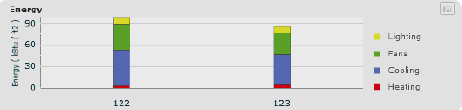
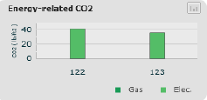
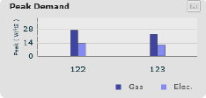
Stephen Blanchard
Construction Management
LEED Implementation
Fisk Corporate Headquarters
Houston, Texas
Project Summary
Analysis #1: Project Sequencing
Sequencing Process
Schedule Results
Cost Implications
Analysis #2: Electrical System Redesign
Electrical Redesign
Redesign Impacts
Analysis #3: Implementation of LEED
LEED Cost Analysis
Architectural Breadth
Energy Impacts
BIM Research
Final Recommendations
Acknowledgments
Eastern Façade Energy Summary
Total Annual Energy Savings
11.9 (kBtu/ft^2)
Peak Electric Demand Savings
1.6 (W/ft^2)
CO2 Emissions Reduction
5.5 (lbs/ft^2)
Total Annual Energy
  Left = Before Shading; Right = After Shading
CO2 Emissions
Peak Energy Demand

Slide 28
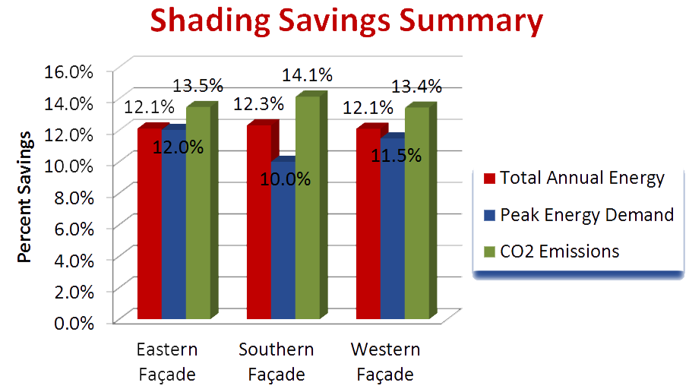
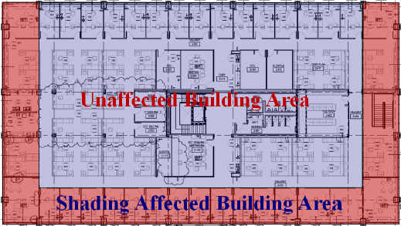
Stephen Blanchard
Construction Management
LEED Implementation
Fisk Corporate Headquarters
Houston, Texas
Project Summary
Analysis #1: Project Sequencing
Sequencing Process
Schedule Results
Cost Implications
Analysis #2: Electrical System Redesign
Electrical Redesign
Redesign Impacts
Analysis #3: Implementation of LEED
LEED Cost Analysis
Architectural Breadth
Energy Impacts
BIM Research
Final Recommendations
Acknowledgments
Energy Summary
Average Energy Reduction
12%
Affected to Unaffected Ratio
1:2
12% * 1/3 = 4%
*Loading Higher in Solar Areas vs. Non-Solar

Slide 29
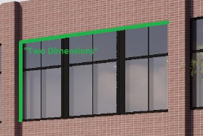
Stephen Blanchard
Construction Management
LEED Implementation
Fisk Corporate Headquarters
Houston, Texas
Project Summary
Analysis #1: Project Sequencing
Sequencing Process
Schedule Results
Cost Implications
Analysis #2: Electrical System Redesign
Electrical Redesign
Redesign Impacts
Analysis #3: Implementation of LEED
LEED Cost Analysis
Architectural Breadth
Energy Impacts
BIM Research
Final Recommendations
Acknowledgments
Problem Background
Unusual Façade Installation
$20,000 in Back Chargers
Façade Already Modeled by Architect & Structural
$5,280 to Implement BIM Façade Detailing
Worker Tolerance Error
“Two Dimensions”
BIM to Implement Architectural Overhangs
Overhangs Designed in Revit
Easy to Communicate Technical Overhang Information to Team
Quicker Transition Between the Designs
4D Installation Sequence

Slide 30
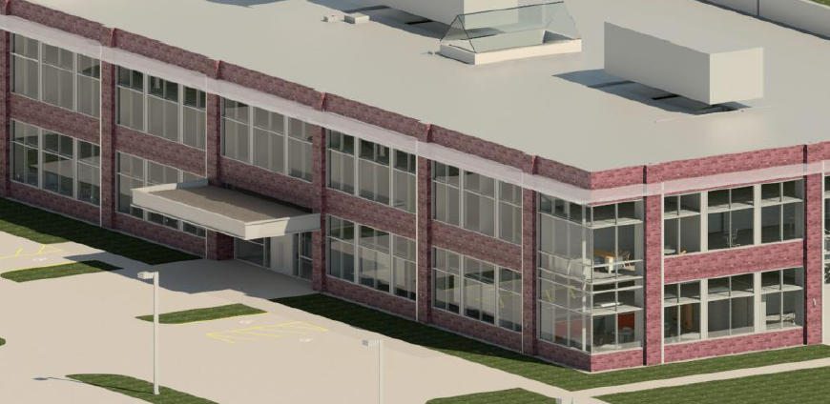

Stephen Blanchard
Construction Management
Final Recommendations
Fisk Corporate Headquarters
Houston, Texas
Project Summary
Analysis #1: Project Sequencing
Sequencing Process
Schedule Results
Cost Implications
Analysis #2: Electrical System Redesign
Electrical Redesign
Redesign Impacts
Analysis #3: Implementation of LEED
LEED Cost Analysis
Architectural Breadth
Energy Impacts
BIM Research
Final Recommendations
Acknowledgments
Savings Summary
Analysis #1
$50,698
Analysis #2
$11,669
Analysis #3
($28,266)
Total Savings
$34,101
Analysis #1: Project Sequencing
Cost Savings: $50,698
Schedule Savings: 4 Weeks
5% Reduction in Owner Carried General Conditions
Analysis #2: Electrical System Redesign
Cost Savings: $11,669
Schedule Savings: 4.5 Days
Fewer Components to Maintain & Service
No Additional Constructability Concerns
Analysis #3
Cost Incurred: $28,266
Gained LEED Building Certification
1% Reduction in State Property Tax
Improved Specialty Contractor Image
Architectural Overhangs Adopted
Gained LEED Silver
4% Minimum Improvement in Energy Efficiency
BIM Implementation to Ease Design Change

Slide 31
Stephen Blanchard
Construction Management
Acknowledgements
Fisk Corporate Headquarters
Houston, Texas
Project Summary
Analysis #1: Project Sequencing
Sequencing Process
Schedule Results
Cost Implications
Analysis #2: Electrical System Redesign
Electrical Redesign
Redesign Impacts
Analysis #3: Implementation of LEED
LEED Cost Analysis
Architectural Breadth
Energy Impacts
BIM Research
Final Recommendations
Acknowledgments
Academic
Dr. John Messner
Dr. Robert Leicht
Dr. Richard Mistrick
Professor Dodson
Professor Holland
Penn State AE Faculty
Industry
Special Thanks
Wayne McDonald
David Rinehart
Ted Robertson
Fisk Corporate Headquarters Project Team
PACE Industry Members
My Family and Friends

Slide 32
Stephen Blanchard
Construction Management
Questions?
Fisk Corporate Headquarters
Houston, Texas
Project Summary
Analysis #1: Project Sequencing
Sequencing Process
Schedule Results
Cost Implications
Analysis #2: Electrical System Redesign
Electrical Redesign
Redesign Impacts
Analysis #3: Implementation of LEED
LEED Cost Analysis
Architectural Breadth
Energy Impacts
BIM Research
Final Recommendations
Acknowledgments
Savings Summary
Analysis #1
$50,698
Analysis #2
$11,669
Analysis #3
($28,266)
Total Savings
$34,101
Analysis #1: Project Sequencing
Cost Savings: $50,698
Schedule Savings: 4 Weeks
5% Reduction in Owner Carried General Conditions
Analysis #2: Electrical System Redesign
Cost Savings: $11,669
Schedule Savings: 4.5 Days
Fewer Components to Maintain & Service
No Additional Constructability Concerns
Analysis #3
Cost Incurred: $28,266
Gained LEED Building Certification
1% Reduction in State Property Tax
Improved Specialty Contractor Image
Architectural Overhangs Adopted
Gained LEED Silver
4% Minimum Improvement in Energy Efficiency
BIM Implementation to Ease Design Change

Slide 33


Stephen Blanchard
Construction Management
Appendices – Project Sequencing
Fisk Corporate Headquarters
Houston, Texas
Original General Conditions Estimate
Revised General Conditions Estimate

Slide 34


Stephen Blanchard
Construction Management
Appendices – Electrical Redesign
Fisk Corporate Headquarters
Houston, Texas
Panelboard DP
Panelboard H-1
Panelboard H-2

Slide 35



Stephen Blanchard
Construction Management
Appendices – Electrical Redesign
Fisk Corporate Headquarters
Houston, Texas
Panelboard L-1
Panelboard L-1B
Original Bill of Material

Slide 36



Stephen Blanchard
Construction Management
Appendices – Electrical Redesign
Fisk Corporate Headquarters
Houston, Texas
Original Bill of Material
Redesigned Bill of Material
Redesigned Bill of Material

Slide 37








Stephen Blanchard
Construction Management
Appendices – LEED
Fisk Corporate Headquarters
Houston, Texas
Eastern Façade Energy Charts
Southern Façade Energy Charts
Western Façade Energy Charts

